Slide 1
The Ostrich Effect
By:
Mohammad Yehya (k213309)
Muhammad Hasan (k214885)
Muhammad Salar (k214619)

Slide 2
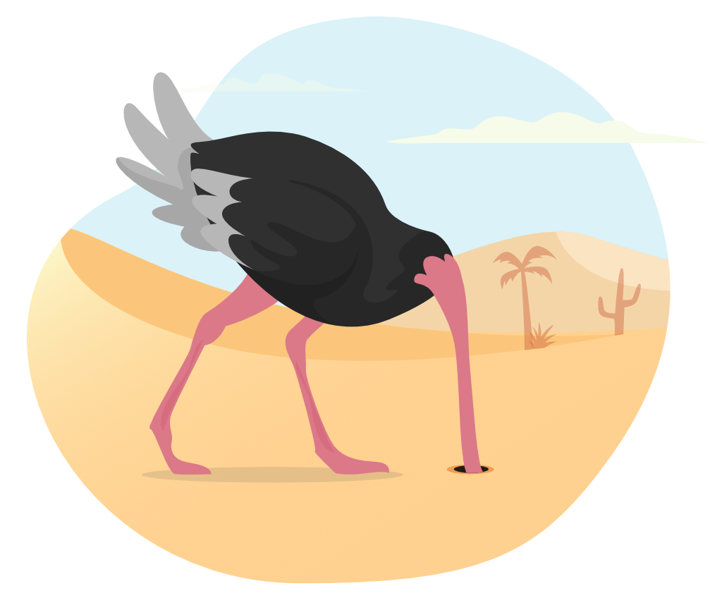
What is the Ostrich Effect?
The ostrich effect is a cognitive bias to prefer hide from rather than facing unpleasant and negative information.
In terms of management it could be used to describe people who avoid knowing the risk of certain financial decisions or situations.
Managers who work in an organization under the ostrich effect may say things like “Don’t come to me with problems, come to me with solutions!”

Slide 3
Consequences of the Ostrich Effect
The ostrich effect heavily influences the culture of an organization.
For example, organizations under the influence of the ostrich effect tend to have employees that are not innovative and are not people oriented.
It also goes against some of the KAIZEN principles like, make corrections or be economical.
All of these accumulate to hinder an organization’s progress and eventually is the cause of its downfall.

Slide 4
Consequences of the Ostrich Effect
The following chart shows the productivity of two organizations, one with and the other without the ostrich effects.
It is clear that the productivity of company B is plummeting over the years due to the compounding consequences of the ostrich effect.

Slide 5

Victims of the Ostrich Effect
Nokia: Once the world’s dominant mobile phone manufacturer, Nokia quickly lost market share following the release of the iPhone.
An investigation was formed and they determined that the reason Nokia failed was not due to inferior phone hardware, but instead an organizational fear.
This short-sightedness resulted in Nokia quickly being out-innovated by companies.

Slide 6

Victims of the Ostrich Effect
Volkswagen: The culture at Volkswagen under CEO Martin Winterkorn was one based on fear and deception.
Following this scandal, questions arised about how such a culture could have grown, and what needed to change.
They needed a culture in which it’s possible and permissible to argue with your superior about the best way to go.

Slide 7
Solutions to the Ostrich Effect
In order to counteract the ostrich effect, one of the most effective things to do is to build up psychological safety.
For example, this could involve pretending that you’re looking up the information so you can help a friend, rather than to address your own issue.
Another solution is to set up automated external mechanisms that will ensure that you deal with the information you’re trying to avoid.
For example, in the case of your bank balance or utility bills, you can set up scheduled emails or notifications.
Focus on the big picture.

Slide 8
Conclusion
People are biased towards positive information, and are also motivated to protect their own egos. The desire for psychological consistency also plays a role.
To avoid the ostrich effect, try some mindfulness exercises, and try to remind yourself of your long-term goals.
A culture based on fear is one where your teams cannot fly.

Slide 9
THANK YOU!

